Slide 1
Hobby Web Application
Felix Marley

Slide 2

Motivation
Notes:
Environment conservation, school, interesting properties, long lifespans, wanted to research further

Slide 3
Objectives
Agile, Project Management & Consultancy Skills
Databases
Cloud Fundamentals
Programming Fundamentals
Continuous Integration
Front-End Web Technologies
Automated Testing
API Development
To create an OOP web application which is full stack.

Slide 4
Project documentation

Slide 5
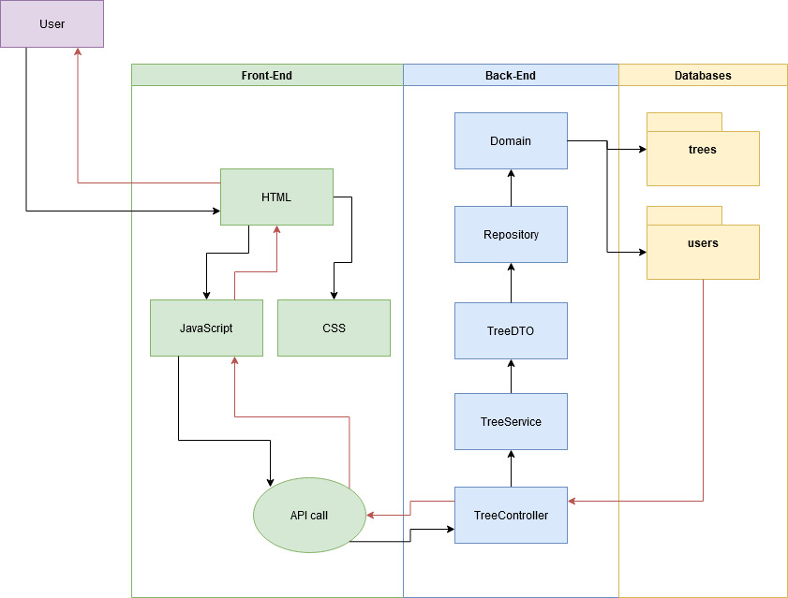
Project Documentation
Unified Modelling Language (UML)

Slide 6
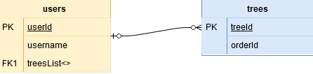
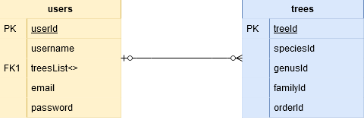
Project Documentation
Entity Relationship Diagram
Basic
Complete

Slide 7
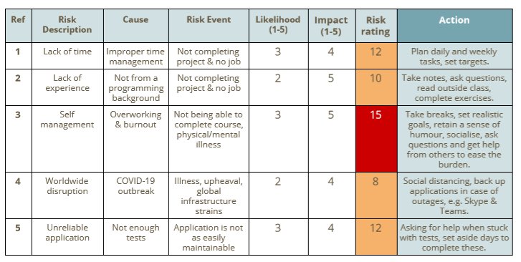
Project Documentation
Risk assessment 1

Slide 8
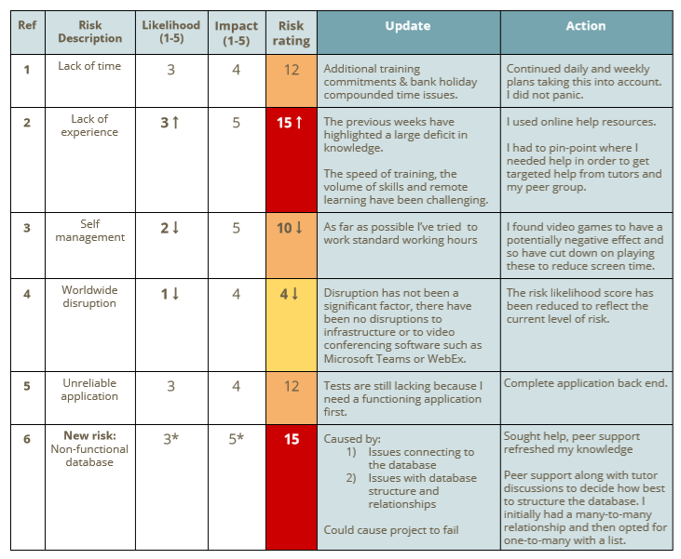
Project Documentation
Risk assessment 2

Slide 9
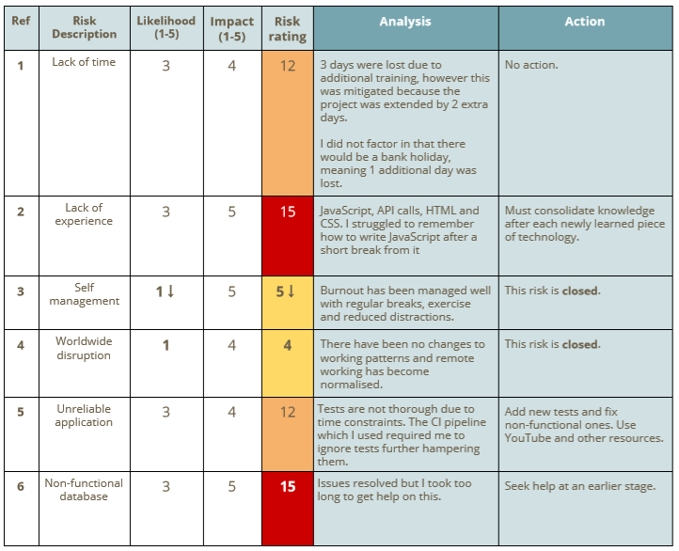
Project Documentation
Risk assessment 3

Slide 10
Kanban Board & Planning

Slide 11
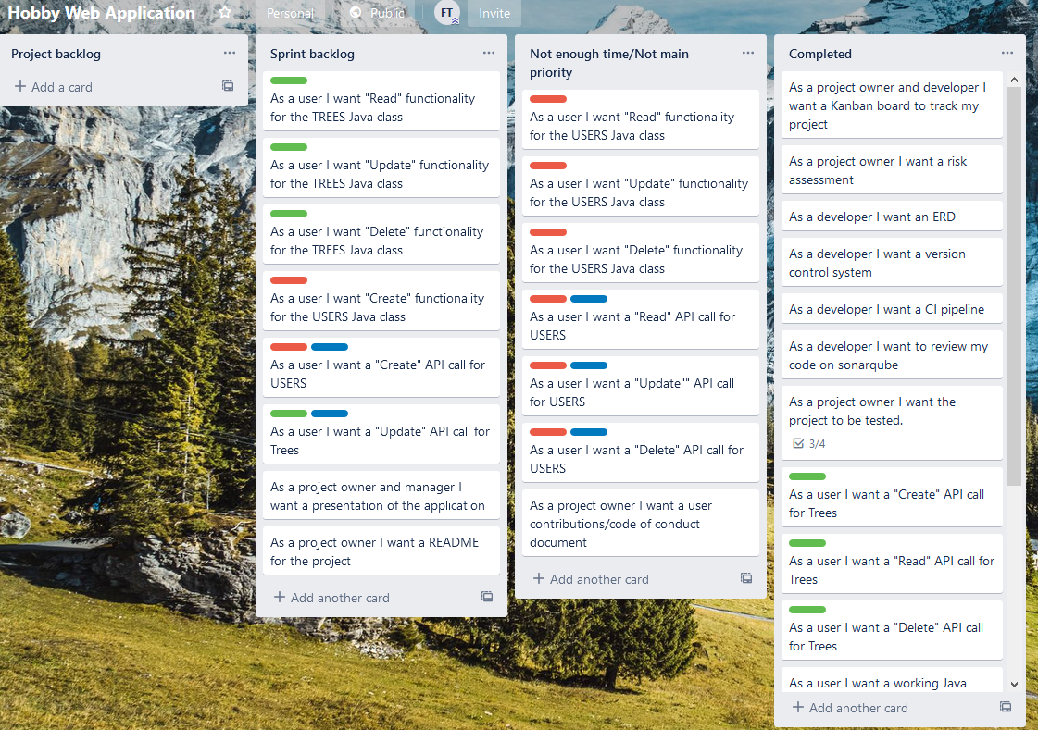
Kanban Board & Planning
Trello

Slide 12
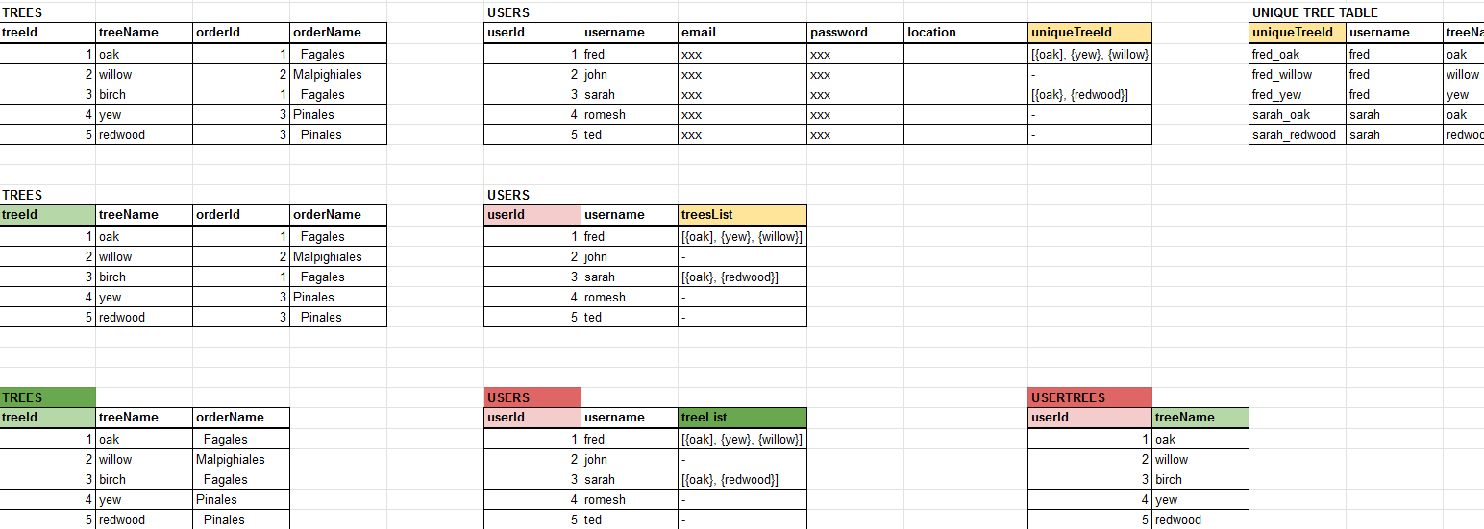
Kanban Board & Planning
Spreadsheets

Slide 13
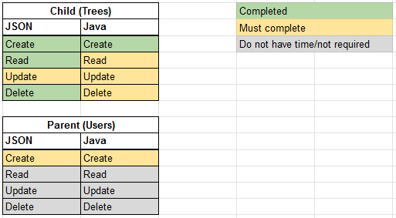
Kanban Board & Planning
Prioritisation

Slide 14
Java and Spring

Slide 15
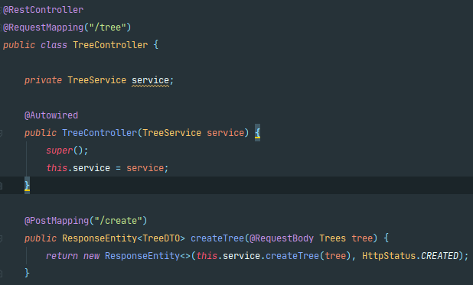
Java and Spring
Spring
Notes:
Spring uses annotations to allow developers to easily connect to databases using API requests

Slide 16
JavaScript, HTML and CSS

Slide 17

API Requests
Notes:
Here I used postman to test the requests with a functioning back end, but without a front end

Slide 18
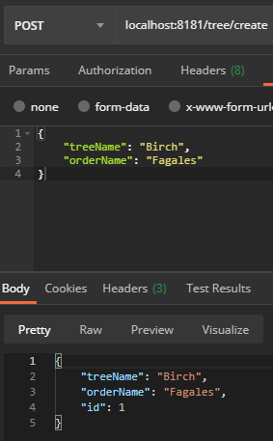
API Requests
“Post”
Function | API name
Create - To add an entry to the database | “POST”

Slide 19
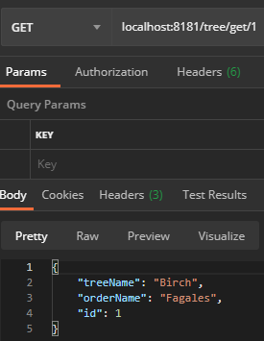
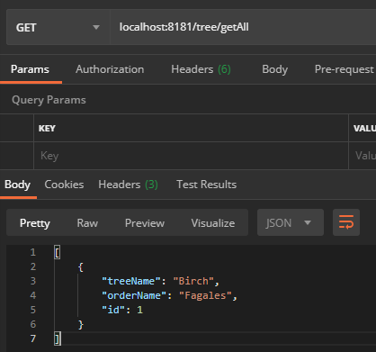
API Requests
“Get”
Function | API name
Read - To view one specific entry in the database | “GET”
Read - To view all entries in the database | “GET”

Slide 20
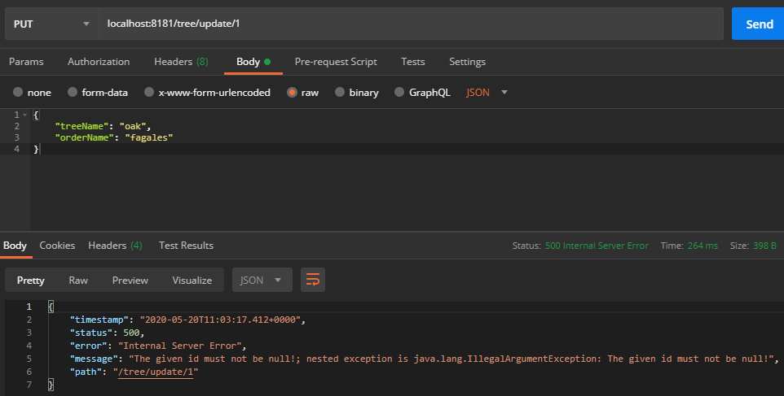
API Request
“Put”
Function | API name
Update - To update an entry in the database | “PUT”
Issue

Slide 21
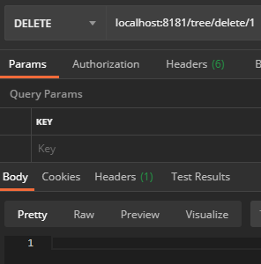
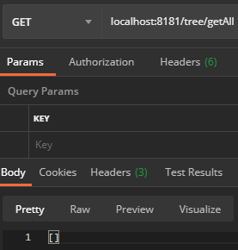
API Requests
“Del”
Function | API name
Delete - To remove an entry from the database | “DEL”
Before
After

Slide 22
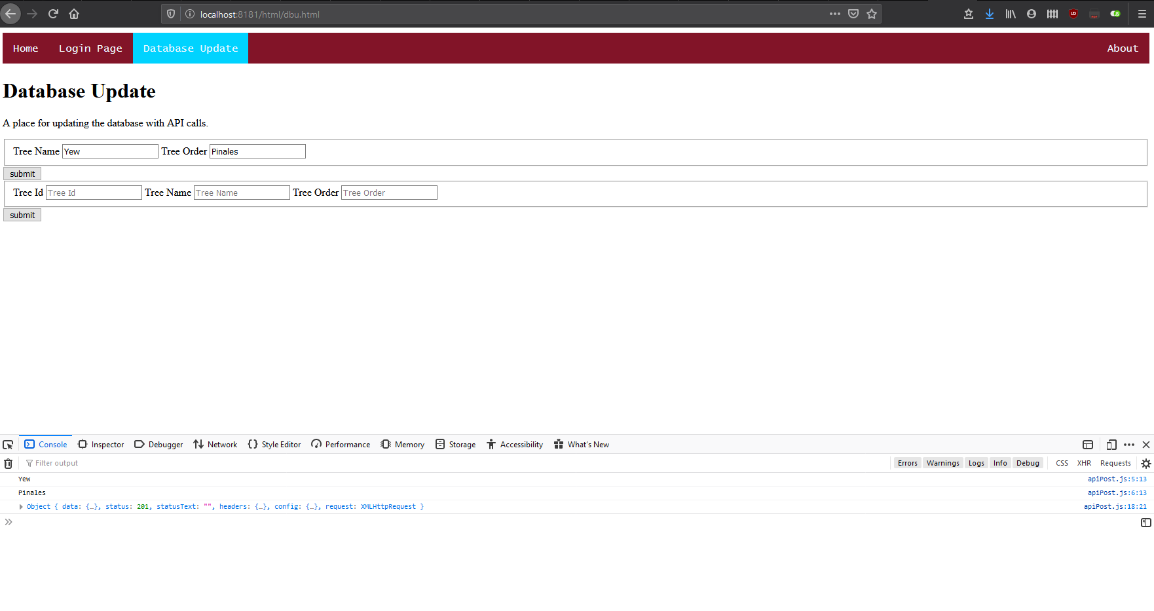
API Requests

Slide 23
Jenkins

Slide 24
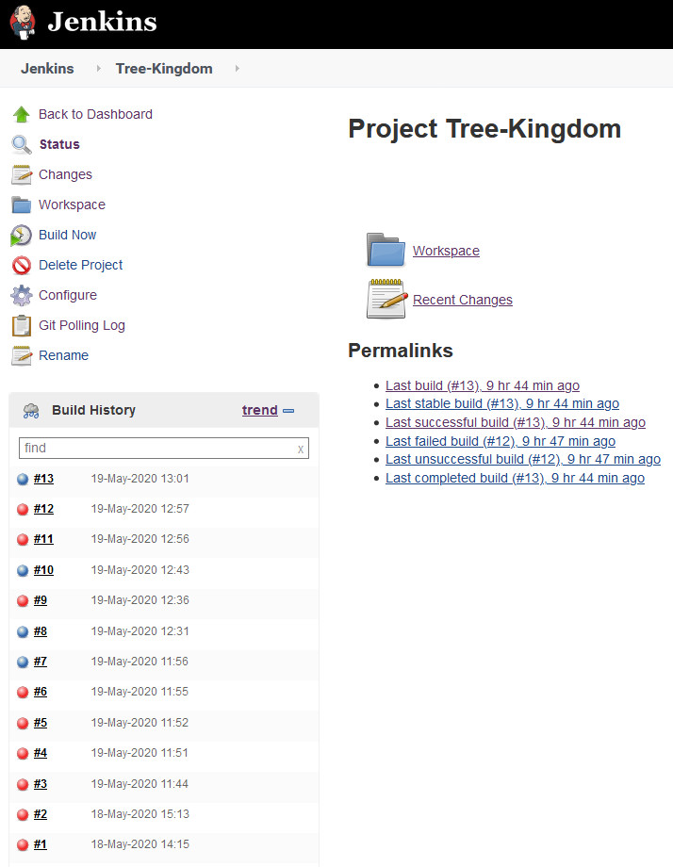
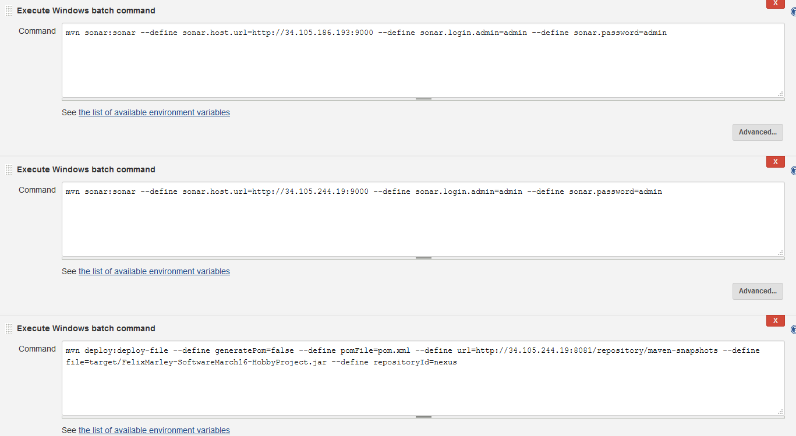
Jenkins

Slide 25
Sonarqube

Slide 26
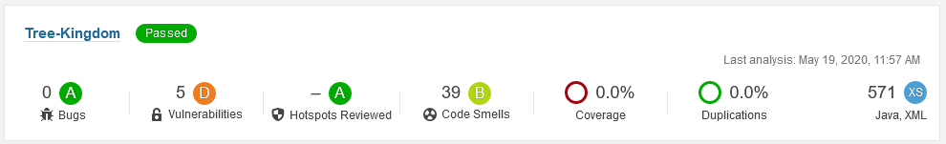
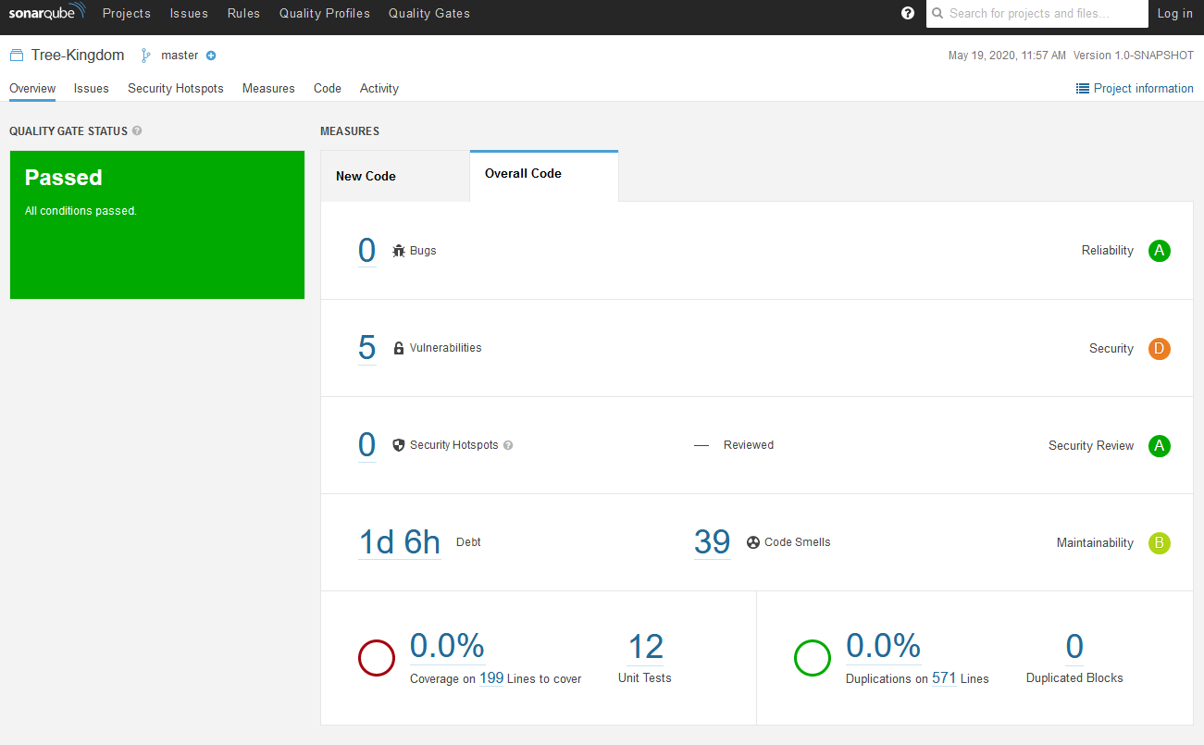
Sonarqube

Slide 27
Version Control

Slide 28
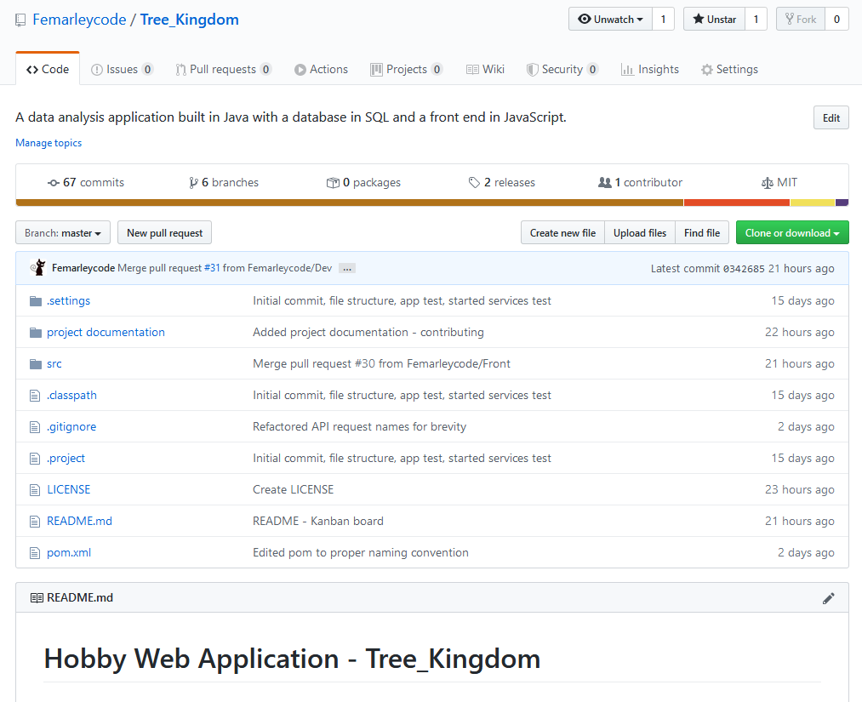
Version Control
Main github page

Slide 29
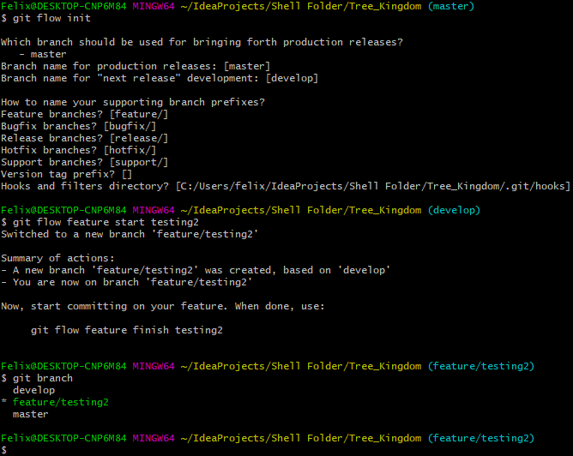
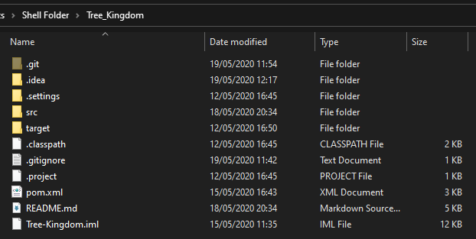
Version Control
Git flow
Directory layout

Slide 30
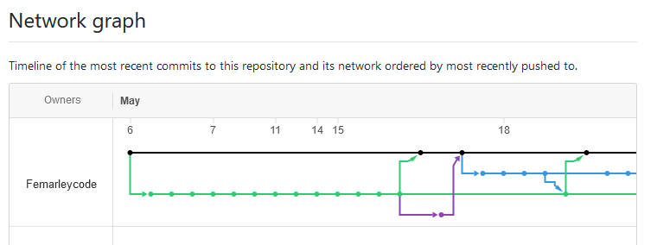
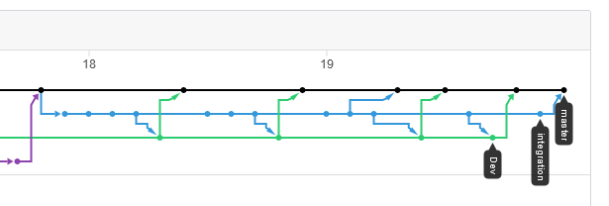
Version Control

Slide 31
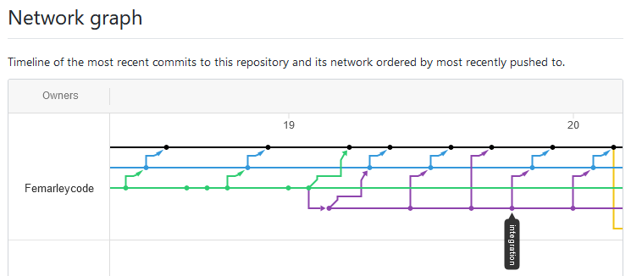
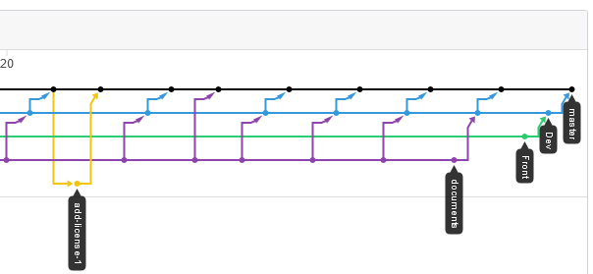
Version Control

Slide 32
Reflection

Slide 33
Reflection
Next steps
Fix key areas for focus
Functionality
API back end
“Update” API call not working - Java
Probably caused by not having parent the class “Users” which contain lists of “Trees”
API front end - JavaScript/HTML
Only “Create” function is completed, “Read”, “Update”, “Delete” functions are unfinished in the application front end.
Extra styling on website interface - CSS & HTML
Current application styling is poor
Feature
Login function - HTML & JavaScript
Would enable different user levels
User data analysis/visualisation support functions - JavaScript
Tests
Larger coverage of tests with Junit and Mockito
Selenium test implementation

Slide 34
Conclusion

Slide 35

Thank you
Notes:
Any questions?

